Slide 1
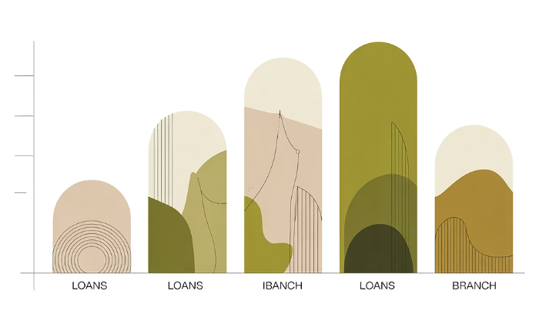
Query 5 — Books Loaned per Branch
Objective: Retrieve the total number of books loaned for each library branch to measure circulation per location. SQL (final):
SELECT lb.library_branch_BranchName, COUNT(bl.book_loans_LoansID) AS Total_Books_LoanedFROM tbl_library_branch lbLEFT JOIN tbl_book_loans bl ON lb.library_branch_BranchID = bl.book_loans_BranchIDGROUP BY lb.library_branch_BranchName;
Notes: LEFT JOIN preserves branches with zero loans so administrators can easily spot inactive locations. Use an index on book_loans_BranchID for performance on large loan tables.
Visualization
Reserve ~20% of the card width on the right for the query output image (chart or table) so results appear alongside the SQL and explanation.

Slide 2


Query 6 — Active Borrowers (More Than 5 Books)
Objective: Identify borrowers who currently have more than five books checked out — useful for targeted communications or policy enforcement. SQL (final):
SELECT br.borrower_BorrowerName, br.borrower_BorrowerAddress, COUNT(bl.book_loans_BookID) AS Books_Checked_OutFROM tbl_borrower brJOIN tbl_book_loans bl ON br.borrower_CardNo = bl.book_loans_CardNoGROUP BY br.borrower_CardNo, br.borrower_BorrowerName, br.borrower_BorrowerAddressHAVING COUNT(bl.book_loans_BookID) > 5;
Notes: Grouping by CardNo ensures correct aggregation. Include name and address in GROUP BY or select them via a subquery to satisfy SQL strictness. Consider adding current_due_date filters to capture only active (not returned) loans.
Action
Send automated reminders or soft notifications to identified borrowers.
Policy
Use results to enforce borrowing caps or temporary blocks to balance availability.

Slide 3



Query 7 — Stephen King Books at Central Branch
Objective: Get a list of Stephen King titles and the number of copies available at the Central branch to support collection planning and inter-branch transfers. SQL (final):
SELECT b.book_Title, lb.library_branch_BranchName, bc.book_copies_No_Of_CopiesFROM tbl_book bJOIN tbl_book_authors ba ON b.book_BookID = ba.book_authors_BookIDJOIN tbl_book_copies bc ON b.book_BookID = bc.book_copies_BookIDJOIN tbl_library_branch lb ON bc.book_copies_BranchID = lb.library_branch_BranchIDWHERE ba.book_authors_AuthorName = 'Stephen King' AND lb.library_branch_BranchName = 'Central';
Notes: This query relies on accurate author-name normalization. Prefer an authors table with author IDs to avoid mismatches from name variations. Use the reserved 20% right-side area for an output image showing a small table or thumbnail list of titles with counts.

Slide 4
Analysis & Insights
Key findings from the queries: - Sharpstown branch shows highest circulation; prioritize supply and staffing adjustments there. - Several titles are available only at specific branches, indicating potential inequity in access — consider redistribution or inter-branch loan policies. - Inactive borrowers and borrowers with high outstanding loans were identified; automate follow-ups to improve turnover. - These insights enable branch-level resource optimization: targeted acquisitions, staffing, and scheduling.
Resource Allocation
Access Equity
Operational Efficiency
Redirect popular titles and additional copies to high-circulation branches to reduce wait times and improve user satisfaction.
Implement inter-branch transfer workflows and short-term loans to ensure patrons can access titles regardless of location.
Use active-borrower data to design reminder cadence and to detect potential account abandonment or abuse.

Slide 5

Conclusion — What We Built and Why It Matters
Summary: - Implemented a normalized SQL library database that enforces referential integrity and reduces redundancy across books, authors, copies, borrowers, and branches. - Analytical queries provided operational intelligence: branch circulation, heavy borrowers, and author-specific inventory at branches. - These outcomes make day-to-day library operations more data-driven and scalable.
Impact
Recommendations
Improved collection strategy, more equitable access, and higher resource utilization.
Adopt regular reporting, index frequently queried columns, and normalize author/branch identifiers to prevent data drift.

Slide 6

Future Enhancements & Roadmap
Proposed next steps to evolve the system: - Add triggers to automatically update book_copies_No_Of_Copies when loans are created or returned to ensure real-time accuracy. - Implement role-based access control so librarians and admins have appropriate permissions for updates, reporting, and data exports. - Build late-fee calculation and notification mechanisms (email/SMS) to improve returns and reduce loss. - Integrate analytics dashboards (BI) and QR-code-based tracking for faster circulation workflows and contactless checkouts.
Automated Triggers
Maintain counts and data integrity automatically at transaction time.
Roles & Security
Protect sensitive borrower data and limit destructive operations.
Dashboards
Operational dashboards that surface trends, overdue items, and branch KPIs in real time.

Slide 7


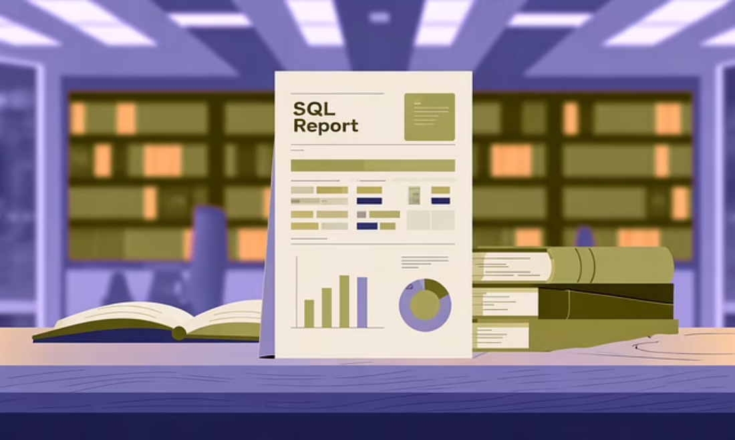
Thank You — Questions?
Contact: ashokt@example.com Please reach out for the SQL scripts, schema DDL, or help implementing triggers and dashboards. We're happy to provide sample code and step-by-step guidance.
Note: For query output visuals, reserve approximately 20% of each query slide's right side for charts or result tables to keep SQL and results side-by-side for clear instructional presentation.

